Slide 1
COURSERa capstone opening a shopping mall
IBM data science
K.ch.s.karthik
07/07/2020

Slide 2
Business problem
• Location of the shopping mall is one of the most important decisions that will determine whether the mall will be a success or a failure
• Objective:
To analyse and select the best locations in the city of Kuala Lumpur, Malaysia to open a new shopping mall
• This project is timely as the city is currently suffering from oversupply of shopping malls.
• Business question
➢In the city of Kuala Lumpur, Malaysia, if a property developer is looking to open a new shopping mall, where would you recommend that they open it?

Slide 3
DATA
Data required
➢List of neighbourhoods in Kuala Lumpur
➢Latitude and longitude coordinates of the neighbourhoods
➢Venue data, particularly data related to shopping malls
• Sources of data
➢Wikipedia page for neighbourhoods (https://en.wikipedia.org/wiki/Category:Suburbs_in_Kuala_Lumpur)
➢Geocoder package for latitude and longitude coordinates
➢Foursquare API for venue data

Slide 4
METHODOLOGY
• Web scraping Wikipedia page for neighbourhood list
• Get latitude and longitude coordinates using Geocoder
• Use Foursquare API to get venue data
• Group data by neighbourhood and taking the mean of the frequency of occurrence of each venue category
• Filter venue category by Shopping Mall
• Perform clustering on the data by using k-means clustering
• Visualize the clusters in a map using Folium

Slide 5
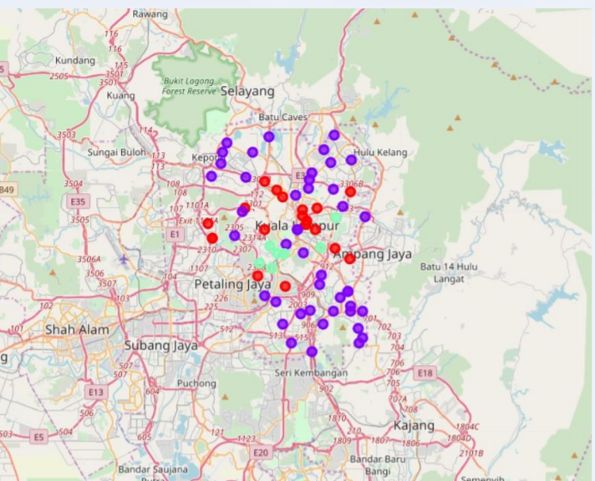
RESULTS
• Categorized the neighbourhoods into 3 clusters :
➢Cluster 0: Neighbourhoods with moderate number of shopping malls ➢Cluster 1:
Neighbourhoods with low number to no existence of shopping malls
➢Cluster 2:
Neighbourhoods with high concentration of shopping malls

Slide 6
DISCUSSIOn
• Most of the shopping malls are concentrated in the central area of the city
• Highest number in cluster 2 and moderate number in cluster 0
• Cluster 1 has very low number to no shopping mall in the neighbourhoods
• Oversupply of shopping malls mostly happened in the central area of the city, with the suburb area still have very few shopping malls

Slide 7
recommendations
Open new shopping malls in neighbourhoods in cluster 1 with little to no competition
• Can also open in neighbourhoods in cluster 0 with moderate competition if have unique selling propositions to stand out from the competition
• Avoid neighbourhoods in cluster 2, already high concentration of shopping malls and intense competition

Slide 8
conclusion
• Answer to business question:
The neighbourhoods in cluster 1 are the most preferred locations to open a new shopping mall
• Findings of this project will help the relevant stakeholders to capitalize on the opportunities on high potential locations while avoiding overcrowded areas in their decisions to open a new shopping mall

Slide 9
thankyou

